Slide 1
Distributed ledger
Prashant Kumar Pandey (2017MCS2100)
Pratham Shah (2017MCS2085)
Shubham Jain (2017MCS2693)

Slide 2
introduction
The aim of this assignment is to implement a distributed ledger.
It enables users to perform some transactions without the help of any central authority.

Slide 3
Components
DNS Server - Responsible for the maintenance of DHT servers and handle the addition of new nodes in the network.
DHT Node(s) - All the DHT servers will be responsible for maintaining hash table of addresses and public keys of all the accounts.
Peer-to-peer network - A network of nodes which are willing to perform transactions.

Slide 4
architecture

Slide 5
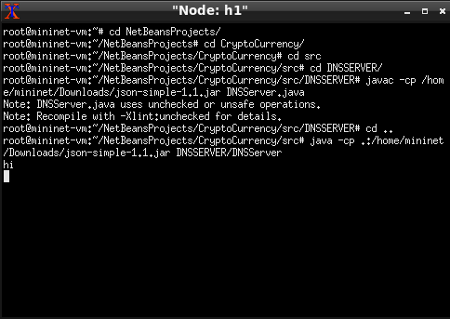
Initialize DNS

Slide 6
Starting of dHT Nodes

Slide 7
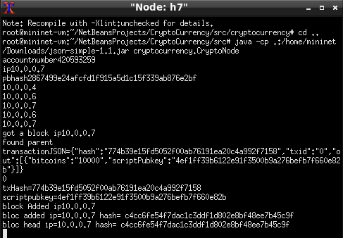
Setting up the network

Slide 8
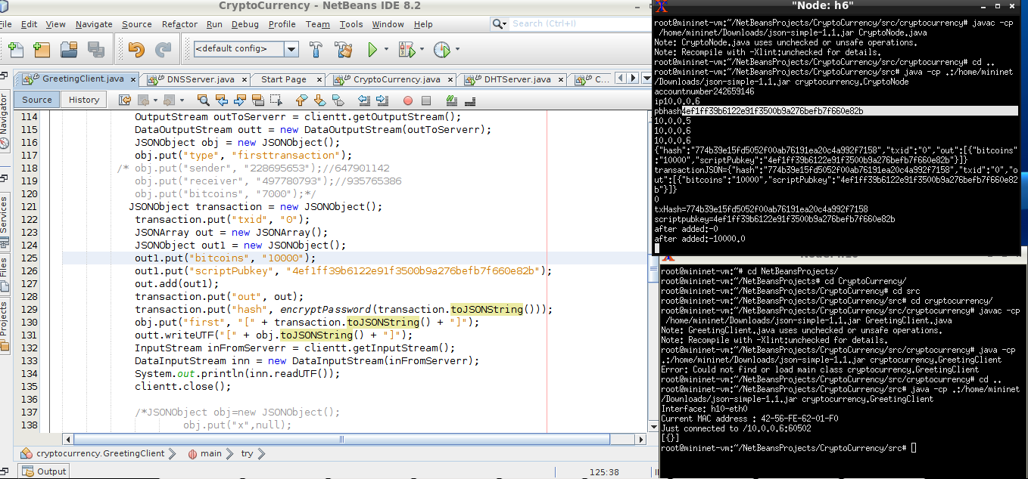
Initiate First transaction

Slide 9
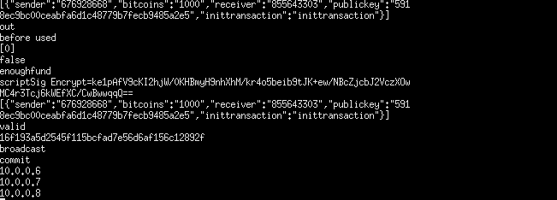
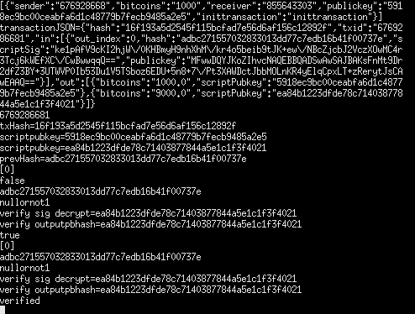
Perform AND VERIFY transactions

Slide 10
Thank you

